Slide 1
Virtual Career Competition- Game Designer
Cameron Bradberry

Slide 2
The Abyss
The Abyss is a game I have created using my imagination.
The game explores what we all fear the unknown. Not knowing what we are facing make us feel fear. You adventure into an unknown place with creatures you can't fathom while being in complete darkness. Like being in the Abyss not knowing what's ahead.

Slide 3
Game Designer
Game Designer is involved in designing content that creates the feel, looks, and gaming experience to the players.

Slide 4
What it takes to be a Game Designer.
Games Designers typically have a bachelor's degree in game design, computer engineering, or computer science which takes 4 to 5 years.

Slide 5
Locations + Salary
Location- Gnomon is a college in hollywood for visual effects, Games, and Animation
Salary- 40k-100k

Slide 6
Why i want to be a Game designer.
I love creating something out of pure imagination and creativity. I love video games .I want to work on video games and maybe one day create one of my own. It's going to be hard but I believe in myself.

Slide 7
Artwork Showcase

Slide 8
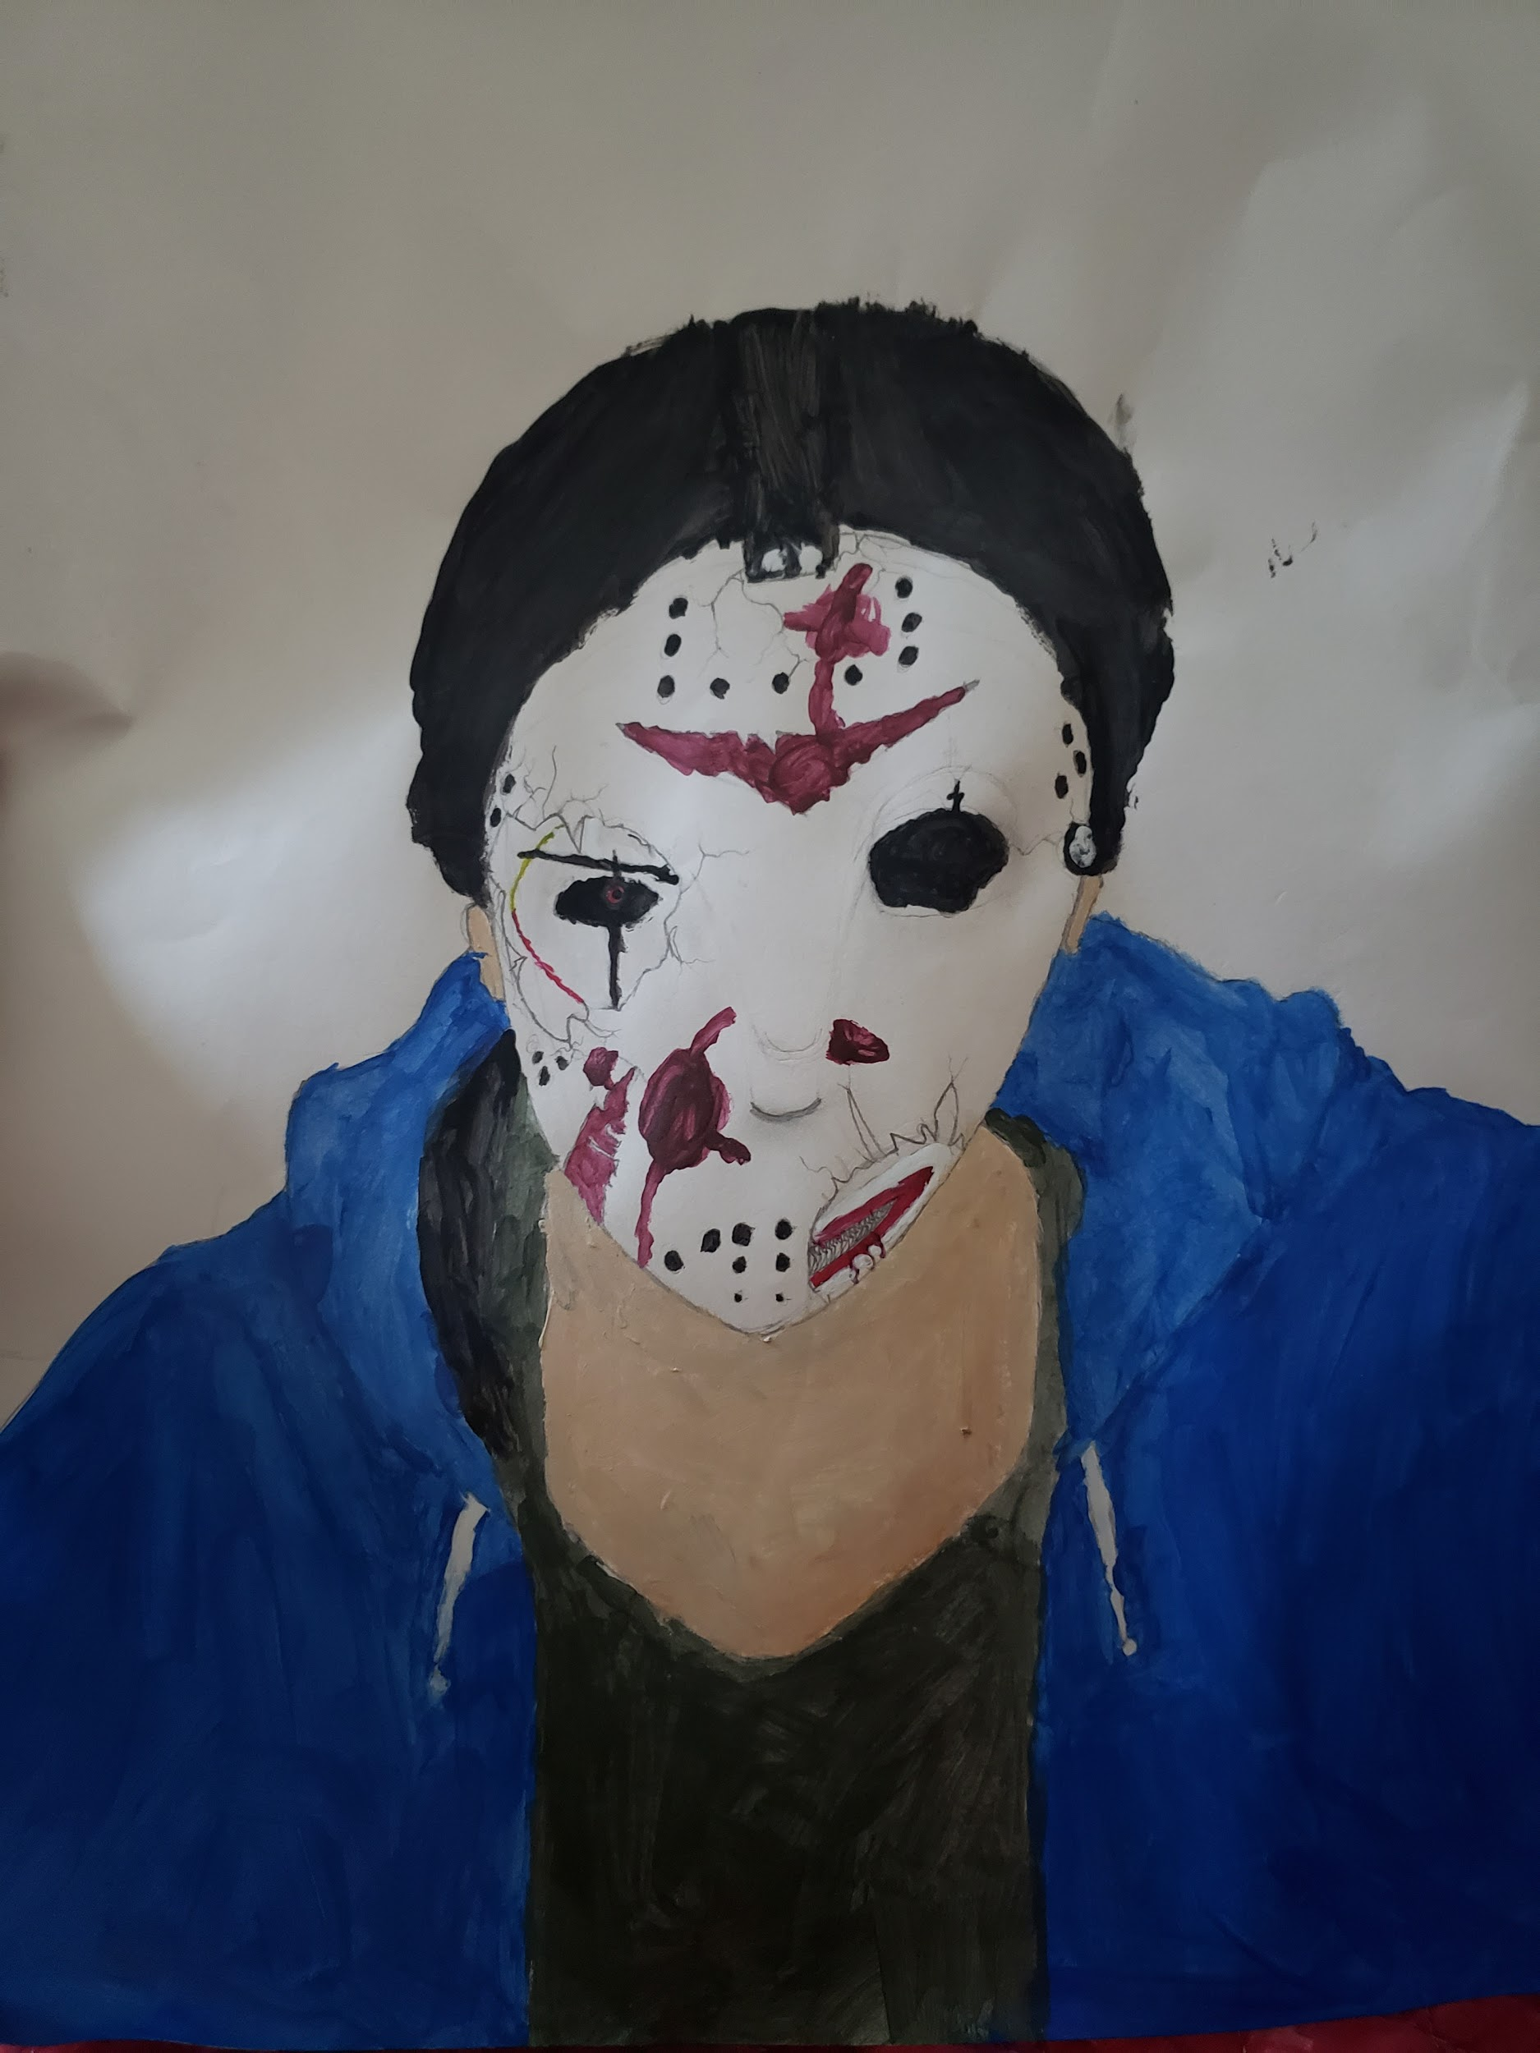
My artwork

Slide 9
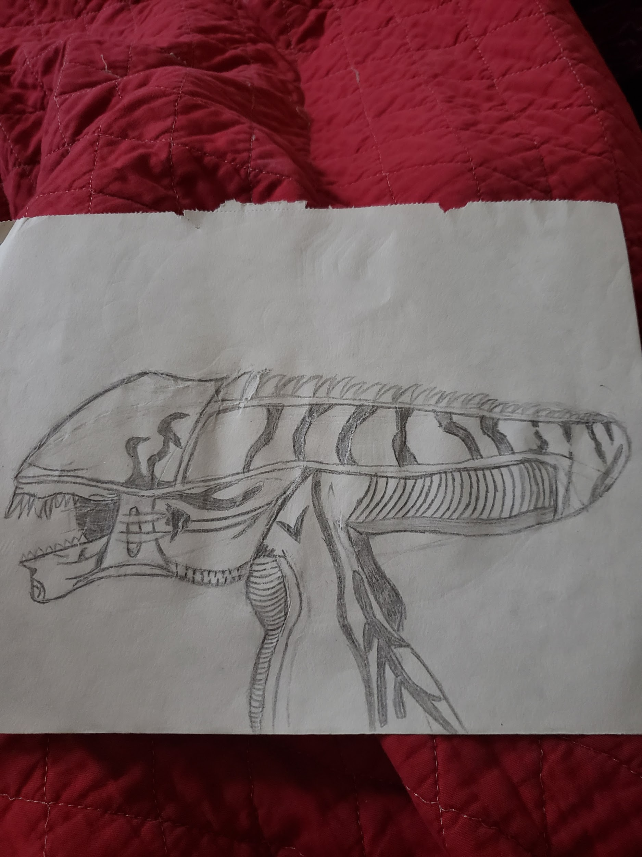
Xenomorph

Slide 10
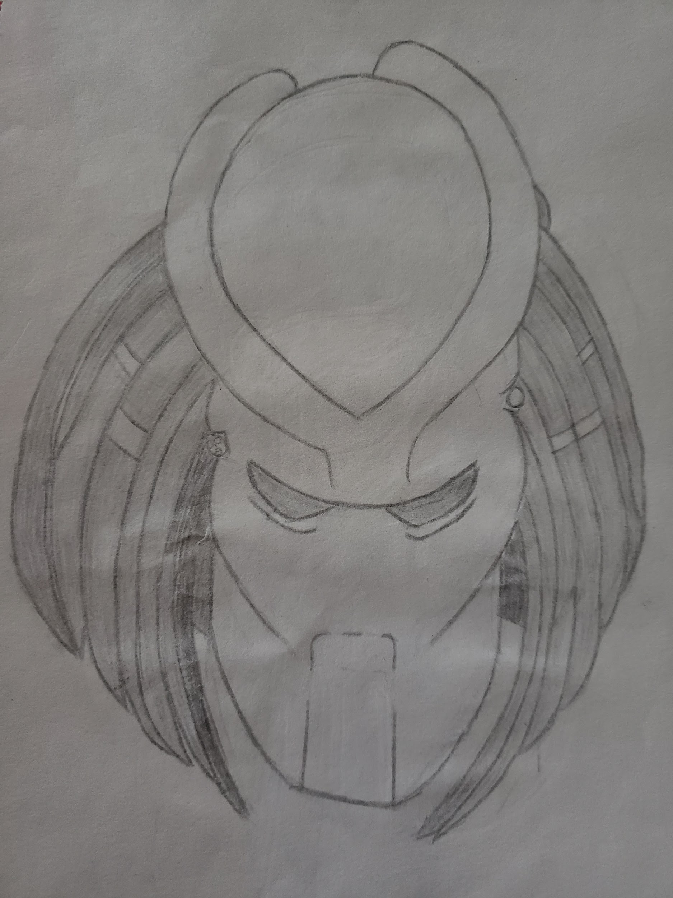
Predator

Slide 11
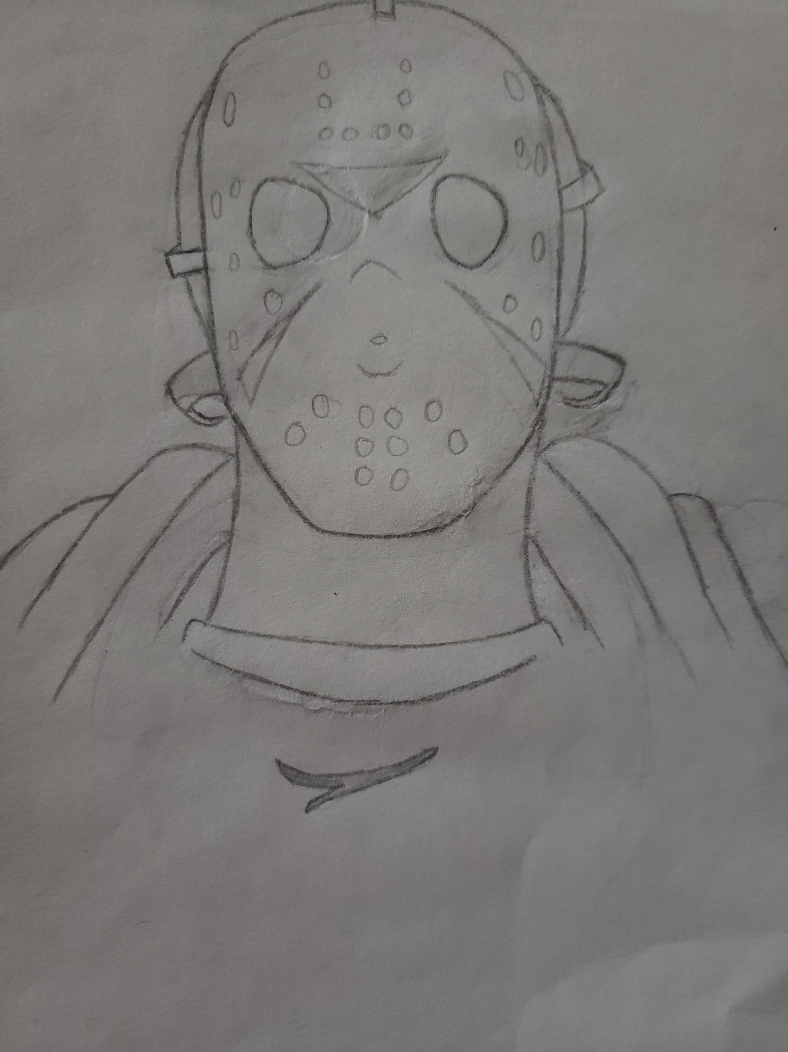
Jason Voorhees

Slide 12
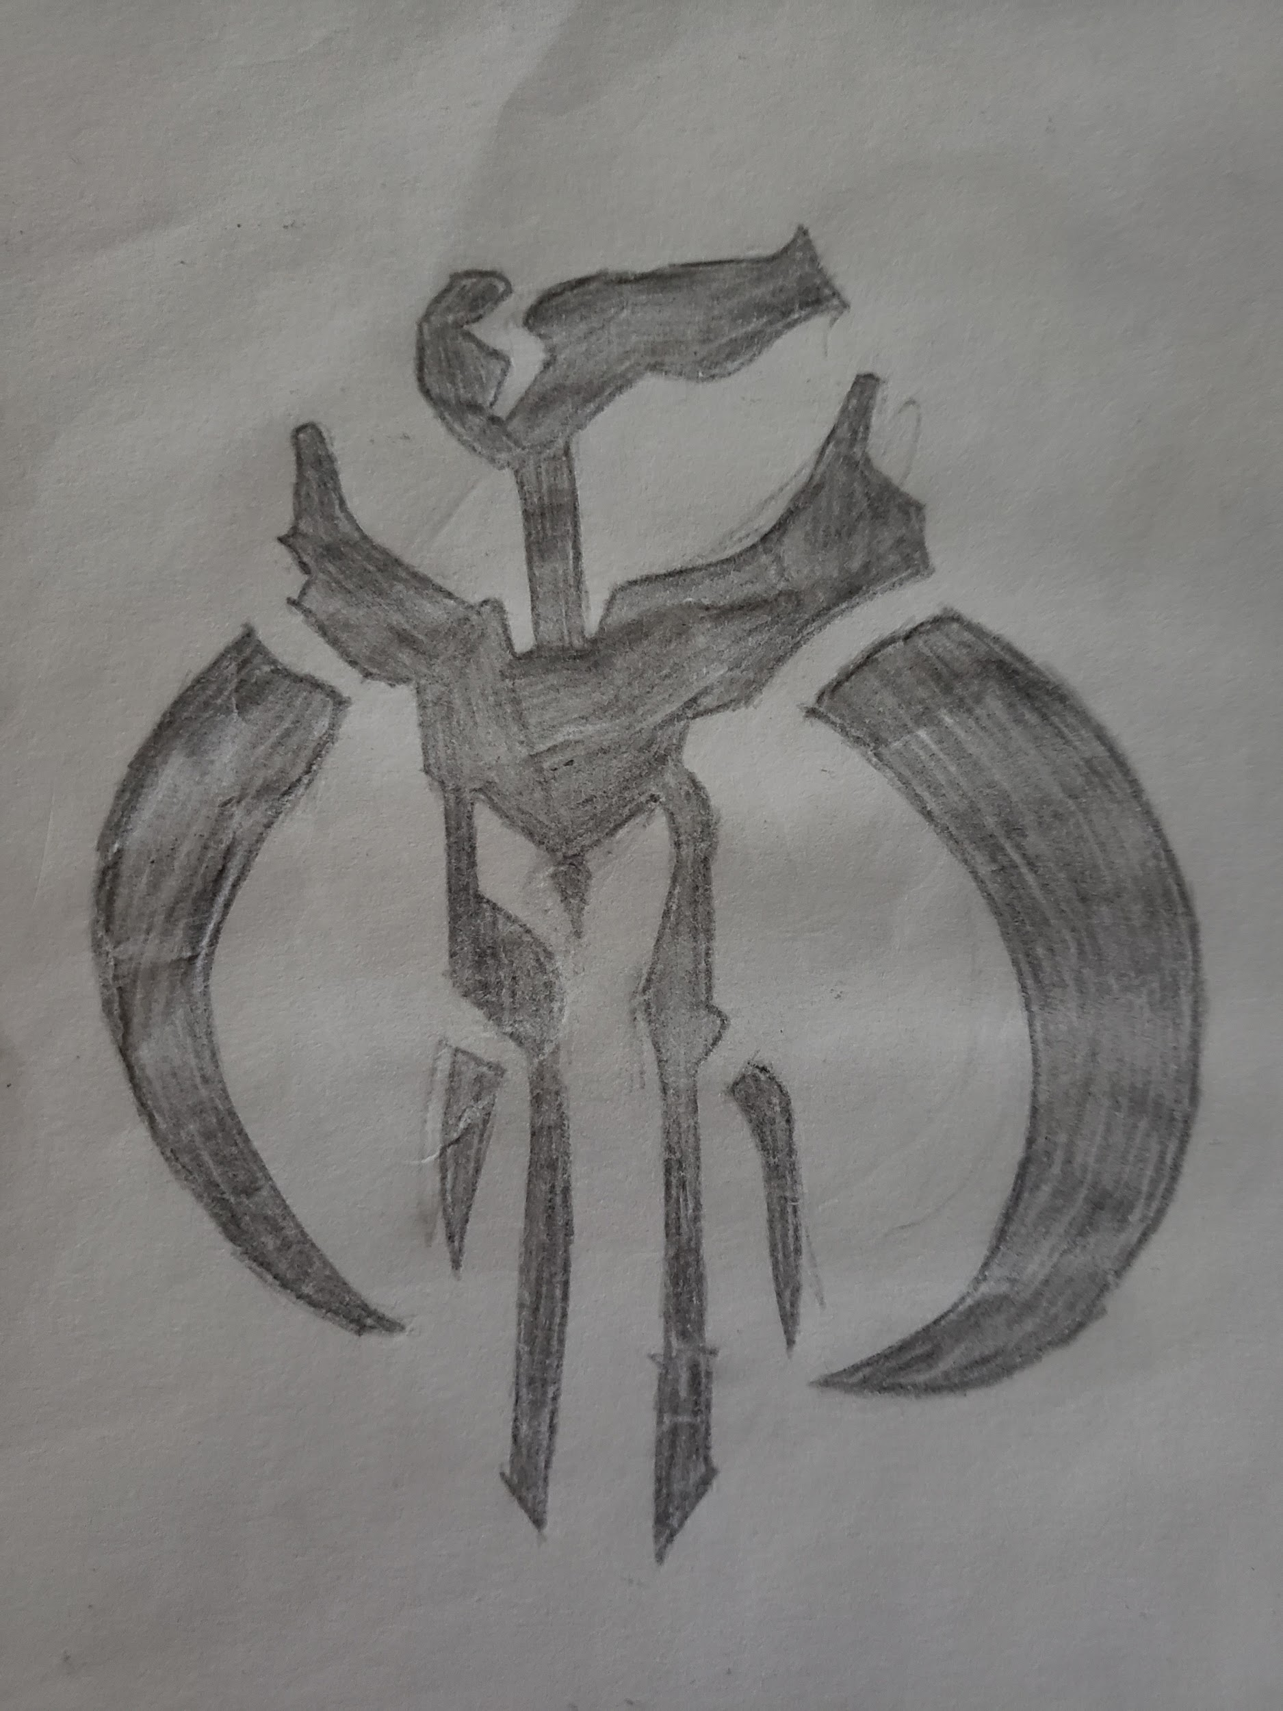
My Art Work

Slide 13
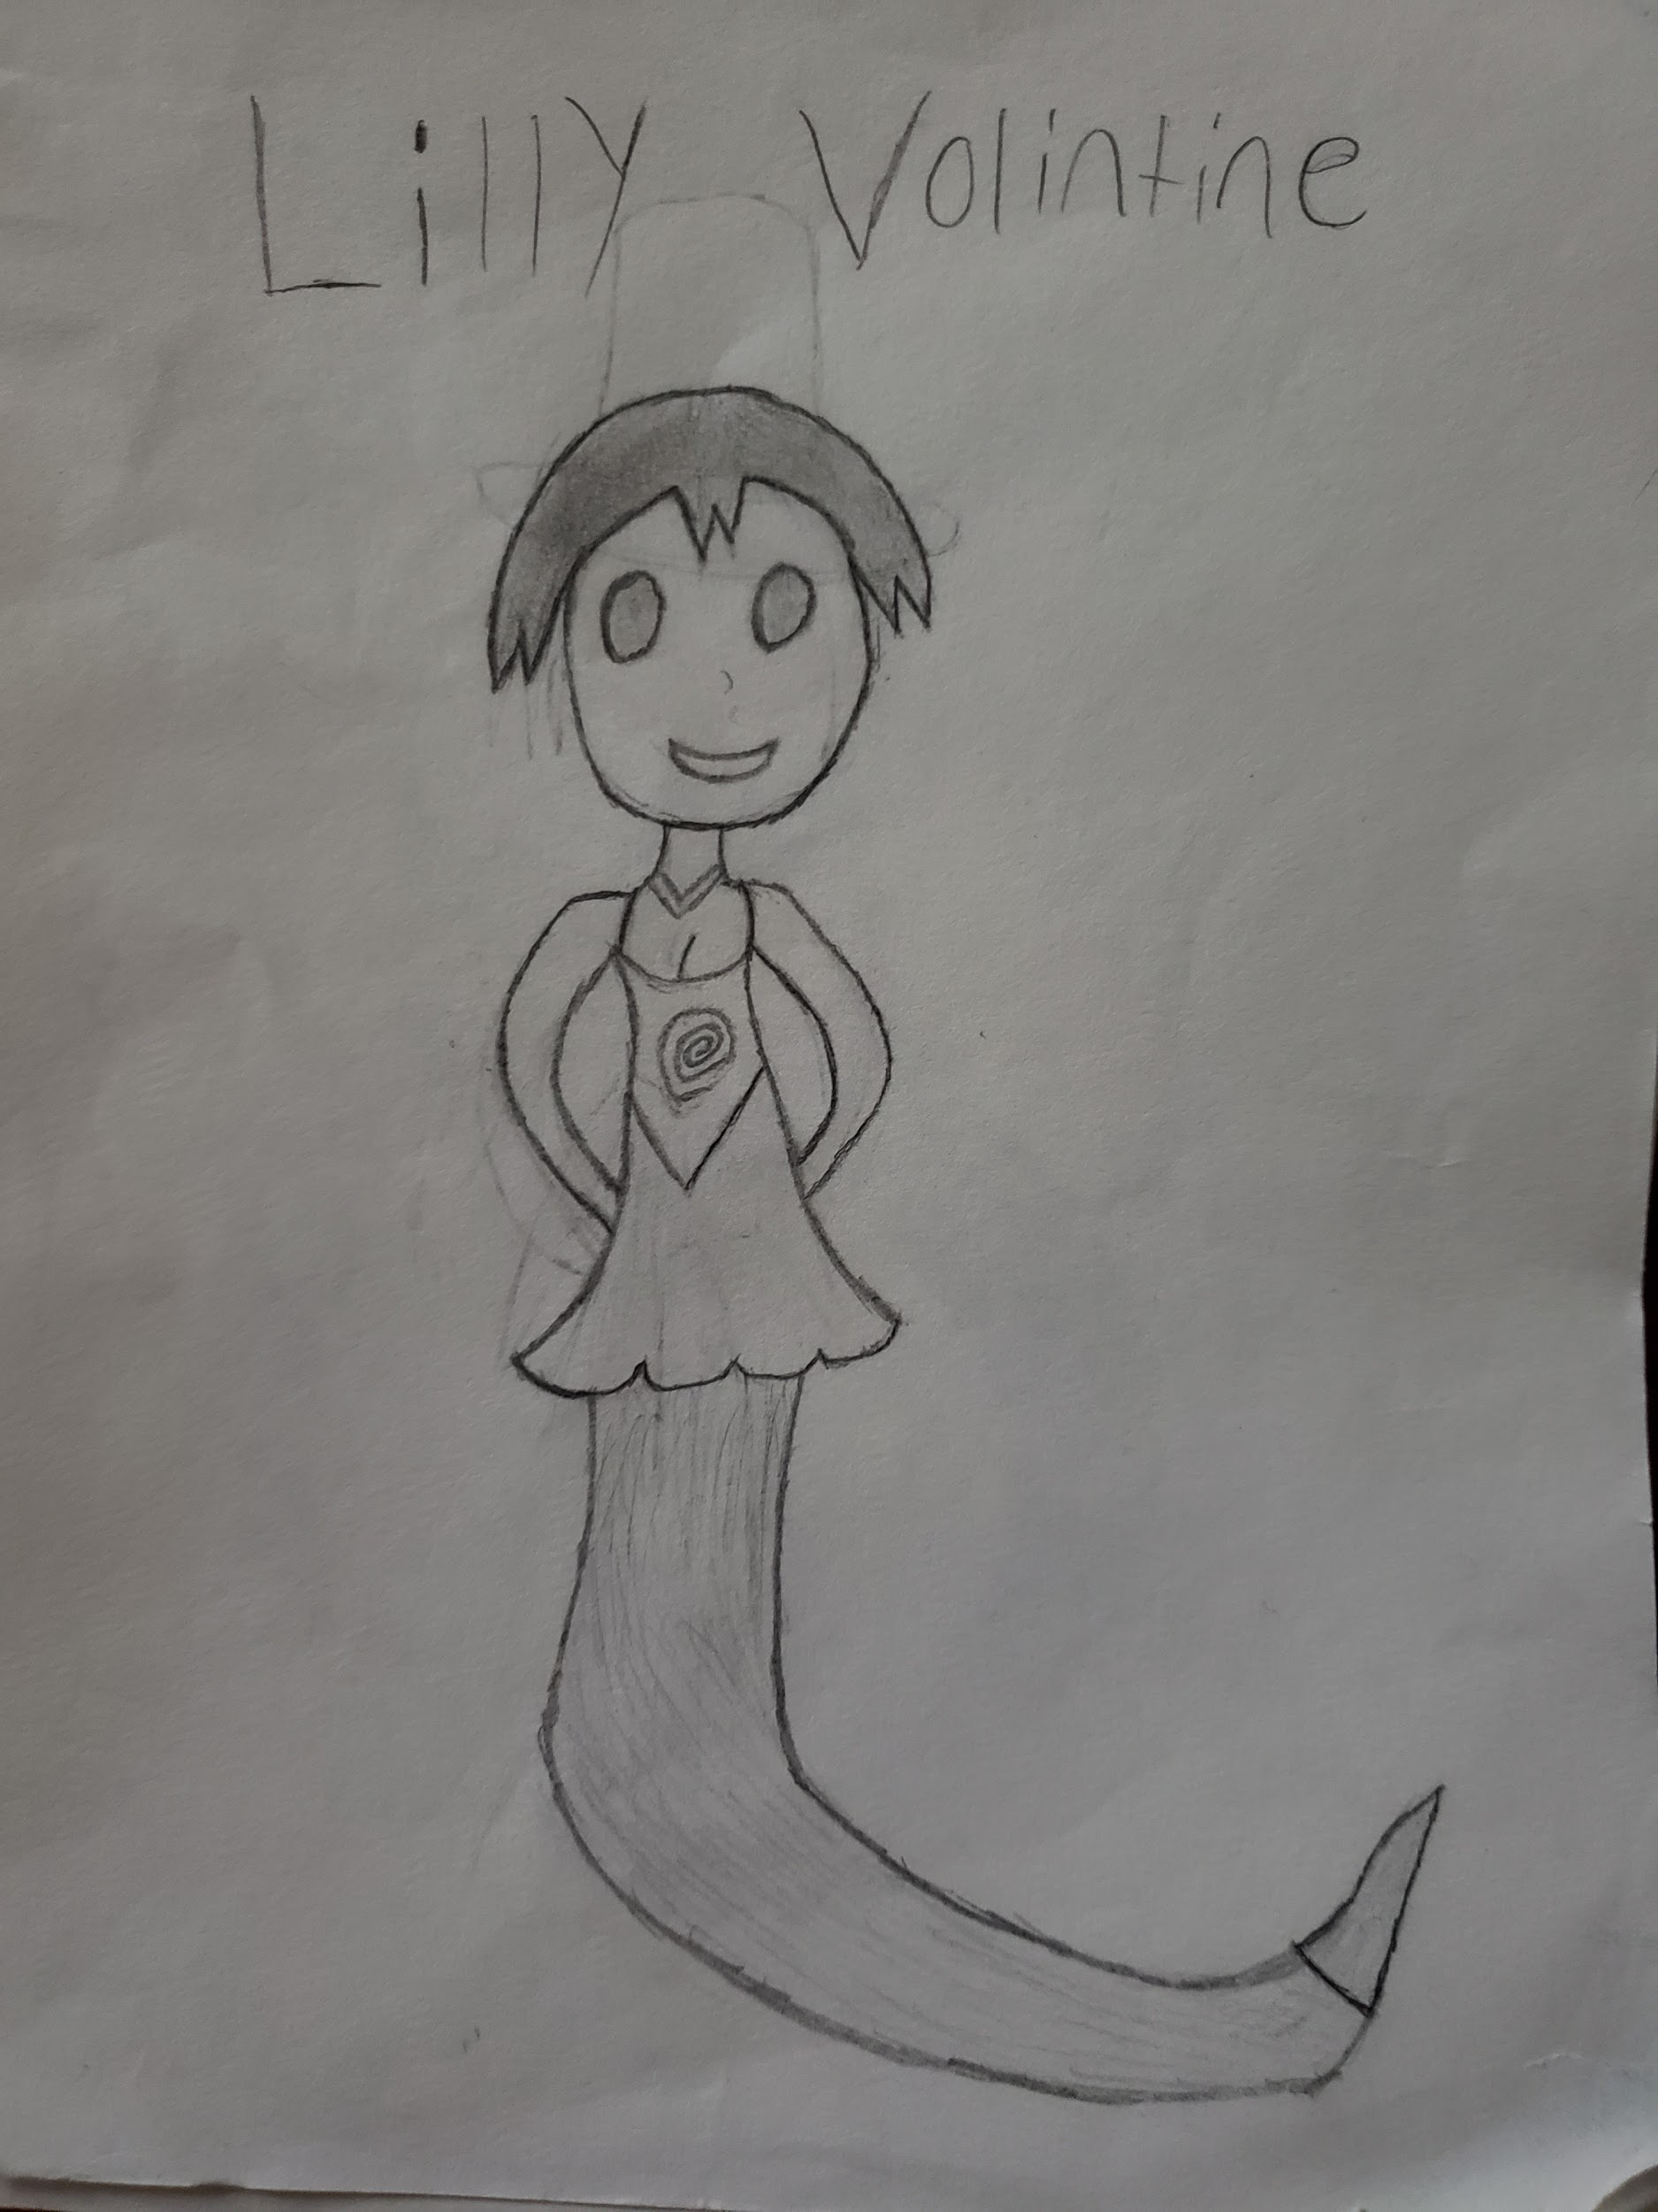
Lilly

Slide 14
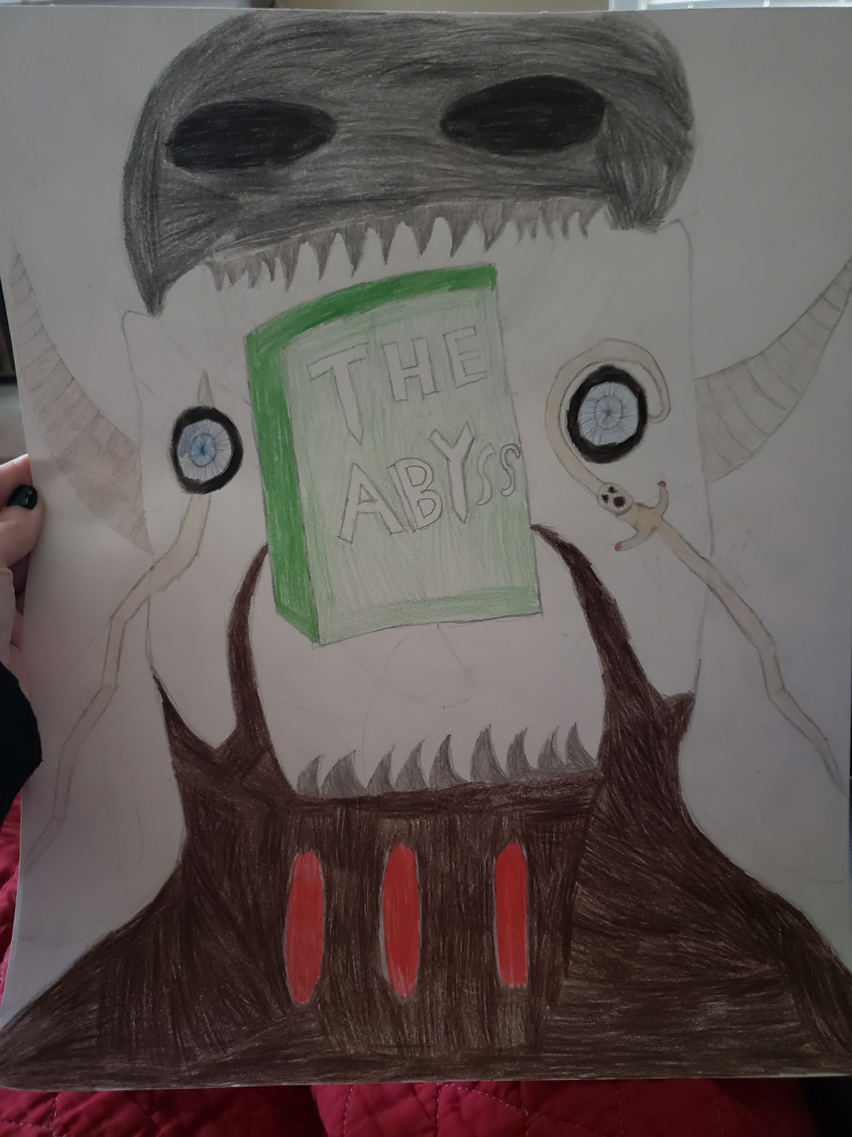
Game poster

