Slide 1
Co-Enrollment
Co-Funding
Outreach &
Recruitment
Heather Pipkin and Liz Smith
April 2022- TEAMS

Slide 2
References
Co-Enrollment
Co-Funding
Outreach and Recruitment
WIOA 1 6.2
20CFR618.325
WIOA 2.7
Workforcegps
Local Area Policies
20CFR683.245
Notes:
There is not a set policy on how to recruit or reach out to your communities. This presentation will provide you with suggestions on how to improve the workflow in each office.

Slide 3
WIOA/TAA Co-Enrollment
It is the shared responsibility of TAA and WIOA to attempt to determine eligibility for and to co-enroll every applicant who is laid off as a result of a permanent closure or a substantial layoff of a trade affected company and who desires assistance in obtaining new employment, unless that person does not qualify for WIOA and/or TAA services
It is also the shared responsibility of TAA and WIOA to work together to give co-enrolled participants the best array of services appropriate for these participants
Once a worker is determined to be TAA-affected, TAA is the priority source of funding if such funding is allowed by TAA.

Slide 4
WIOA/TAA Co-Enrollment (continued)
DOL has established a goal of co-enrolling 75% of TAA participants in either WIOA Title I Adult or Dislocated Worker programs. Therefore, co-enrollment of TAA participants into the WIOA Title I Dislocated Worker or Adult program is strongly encouraged if the TAA participant meets eligibility requirements. The specific services provided to such participants will depend on the needs of the participant and funding availability in the local area.

Slide 5
WIOA Co-Enrollment
Individuals who meet the respective program and service eligibility requirements may participate in Adult/Dislocated Worker and Youth programs concurrently.
Services available under each funding stream will depend on eligibility for services under that funding stream
LWA must track the funding streams that pay the costs of services and ensure no duplication of services [20 CFR 681.430].
WIOA I-B- 2.7 change 1
Notes:
When co-enrolling within WIOA Title 1-B, you will have to track funding to assure funds aren’t crossing programs. Examples: Spend funds in one program and provide non-funded services in the other program. Issue ITA’s in one program and provide supportive services in the other… This must be documented very well in both programs. Reach out to your co-worker, one of you enroll OSY and the other can enroll Adult. This way participants have two to reach out to instead of just one, etc.

Slide 6
Co-enrollment and Co-funding with Other Programs
Providers are encouraged to work with other Workforce Center partners and other entities to provide a full array of needed services to participants. Not only does this strategy provide more services, but it also provides more case management to the participant, thus providing greater probability for success
Providers must not only ensure that participants apply for Pell Grants and other appropriate grants, but they must also coordinate funding with other one-stop partners and other entities for which the participant is eligible [20 CFR 680.230].
Notes:
Research, find out who your contacts are. If you don’t know who to contact, you can’t refer. Every partner is supposed to refer for co-enrollment. Get together with your partner and come up with a game plan. Remember; WIOA is always the last option for funding, Remind your partners of this when speaking with them. let your partner know you are trying to show partnership and provide an array of services to all participants by co-enrolling. You do not have to spend money to co-enroll.

Slide 7

Co-Enrollment equals partnership
The better the partnership the more valuable you are to your participants.

Slide 8

James Moss &
Carole Shaver
Co-enrolling is focused toward providing participants with an array of services so they can achieve their goal.

Slide 9

Do you have to spend money to co-enroll?
Who are the WIOA four core partners?

Slide 10
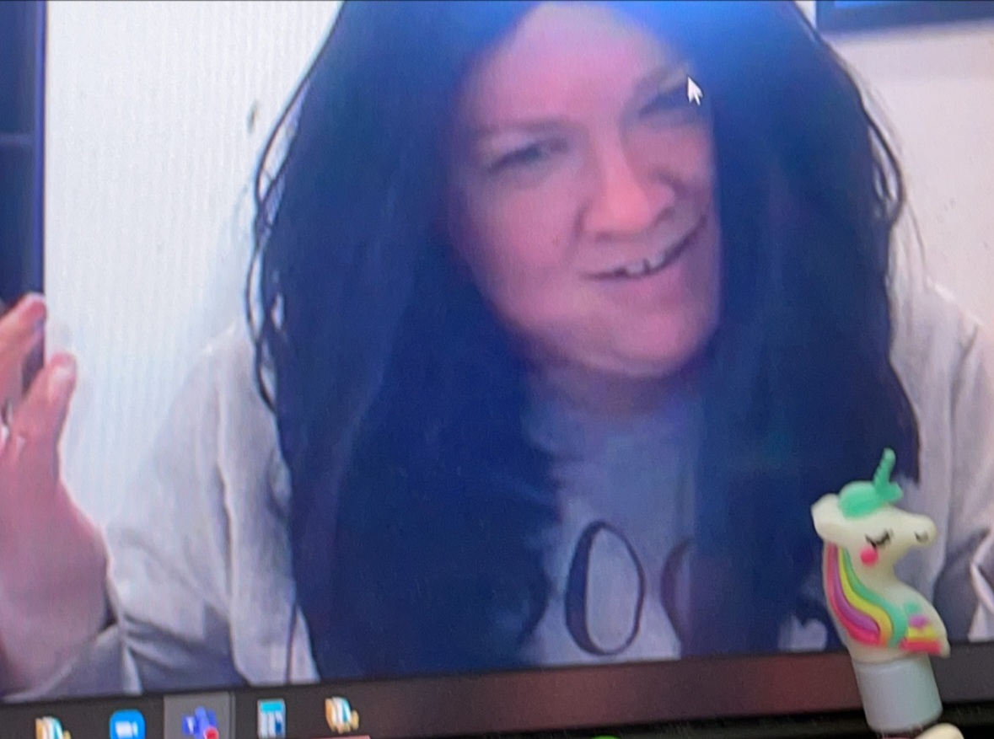
Liz Smith
Outreach and Recruitment

Slide 11



Outreach and Recruitment
Know who you are and what you excel in. Build on your strengths to better serve customers.
Look in the mirror and ask yourself; do I want me, helping me?
Know the ins-outs of what you are speaking on before speaking.
Notes:
Knowledge is the key! The more you know about what you are doing the more confident you will be when speaking to your customers. Your facial expressions roll over into your conversations. Always smile before speaking to your customer. Last but not least; no one knows you better than you, build on that to excel.

Slide 12


Outreach and Recruitment
Get involved in your community
Have fun and enjoy what you do
Notes:
Honestly, if you are at an event or anywhere and sitting there the entire time thinking “I will be glad when this is over” you won’t get much traffic at all. Get involved, smile, have fun with whatever the situation maybe. This small bit of advice will make your job easier.

Slide 13
Outreach & Recruitment
Know your targeted population and who you are recruiting

Slide 14

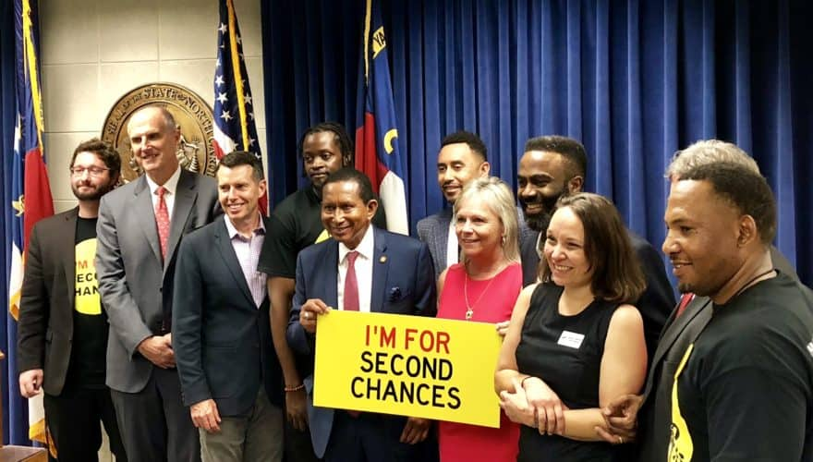
Reaching out to your targeted population
Recruitment
Recruitment
Speak on the level of your targeted population and what they understand. Youth understands $$$$$ not WIOA Services or eligibility. What will benefit them now!
Ex-offenders are looking for that second chance to be on the same level everyone else is without being judged by their past. Focus on getting them to that place by focusing on what benefits them and how they can get to that place.
Notes:
Know your target group, do your research before setting up an event or attending one. Always be prepared and speak the language of your targeted group.

Slide 15
Who are we recruiting and where are we recruiting them?
Notes:
Everyone!

Slide 16
WIOA focuses on the hard to serve participants regardless of the program they are eligible for.
Where would we find customers with barriers?
Just to name a few places
  Parole/probation offices
  County Health Departments
  Low-income housing places
  Adult Education
  TANF
  Resource Room in every Workforce Center
  Department of Human Services
  Partners
Notes:
These are just a few suggestions. Get to know your communities in your area to recruit the above participants. Create a resource manual and keep it updated.

Slide 17
Resource Manual- North Central
Liz Smith

Slide 18
Outreach and Recruitment Role Play
April Flowers
Martha Boyer

Slide 19
Answers to the prize questions
No, you do not have to spend money to co-enroll.
  Remember to always have a co-funding form completed to show services are not being duplicated.
  Core 4 Partners
Title 1B Adult, Dislocated Workers and Youth
Title II Adult Education and Literacy
Title III Wagner Peyser
Title IV Vocational Rehabilitation

Slide 20

Best Practice
Carole Shaver

