Slide 1
Division of Workforce SERVICES PY 2021 PERFORMANCE MEASURES WIOA & Wagner-Peyser AR Workforce Development Board October 18, 2022

Slide 2
PRIMARY Indicators
Employment Rate – 2nd Quarter After Exit:
The percentage of participants who are in unsubsidized employment during the second quarter after exit from the program (for title I Youth, the indicator is the percentage of participants in education or training activities, or in unsubsidized employment during the second quarter after exit)
Employment Rate – 4th Quarter After Exit:
The percentage of participants who are in unsubsidized employment during the second quarter after exit from the program (for title I Youth, the indicator is the percentage of participants in education or training activities, or in unsubsidized employment during the fourth quarter after exit)

Slide 3
PRIMARY Indicators
Median Earnings:
The median earnings of participants who are in unsubsidized employment during the second quarter after exit from the program
Credential Attainment:
The percentage of those participants enrolled in an education or training program and who attain a recognized postsecondary credential or a secondary school diploma, or its recognized equivalent, during participation in or within one year after exit from the program

Slide 4
PRIMARY Indicators
Measurable Skills Gains:
The percentage of program participants who, during a program year, are in an education or training program that leads to a recognized postsecondary credential or employment and who are achieving measurable skill gains, defined as documented academic, technical, occupational, or other forms of
progress, towards such a credential or employment
Documented Progress:
Αchievement of at least one educational functioning level
Attainment of a secondary school diploma or its recognized equivalent
Secondary or postsecondary transcript or report card
Satisfactory or better progress report, towards established milestones, (i.e. OJT & Apprenticeships)
Successful passage of an exam that is required for a particular occupation

Slide 5
WIOA- Title I- PY’ 2021
Statewide PY 2021 Performance Outcomes |  | Employment Rate (Q2) Cohort Period: 7/1/2020-6/30/2021 |  | Employment Rate (Q4) Cohort Period: 1/1/2020-12/31/2020 |  | Median Earnings Cohort Period: 7/1/2020-6/30/2021 |  | Credential Rate Cohort Period: 1/1/2020-12/31/2020 |  | Measurable Skills Gains Cohort Period: 7/1/2021-6/30/2022
Funding Stream |  | Rate | 90% Pass Rate | Rate | 90% Pass Rate | Earnings | 90% Pass Figure | Rate | 90% Pass Rate | Rate | 90% Pass Rate
Adult | Target | 87.0% |  | 75.0% |  | $6,200.00 |  | 82.0% |  | 72.1%
 | Actual | 78.8% | 78.3% | 79.5% |  | $6,754.00 |  | 71.9% | 73.8% | 67.1% | 64.9%
DLW | Target | 91.0% |  | 89.0% |  | $6,900.00 |  | 79.0% |  | 70.2%
 | Actual | 80.0% | 81.9% | 78.0% | 80.1% | $7,986.00 |  | 78.7% | 71.1% | 76.3%
Youth | Target | 80.0% |  | 80.0% |  | $3,024.00 |  | 73.0% |  | 61.0%
 | Actual | 74.5% | 72.0% | 73.9% | 72.0% | $4,407.00 |  | 53.4% | 65.7% | 63.2%
Items Underlined did not meet the target performance level, but did meet the 90% of target minimum requirement
Items bolded and underlined fell below the 90% of target minimum requirement

Slide 6
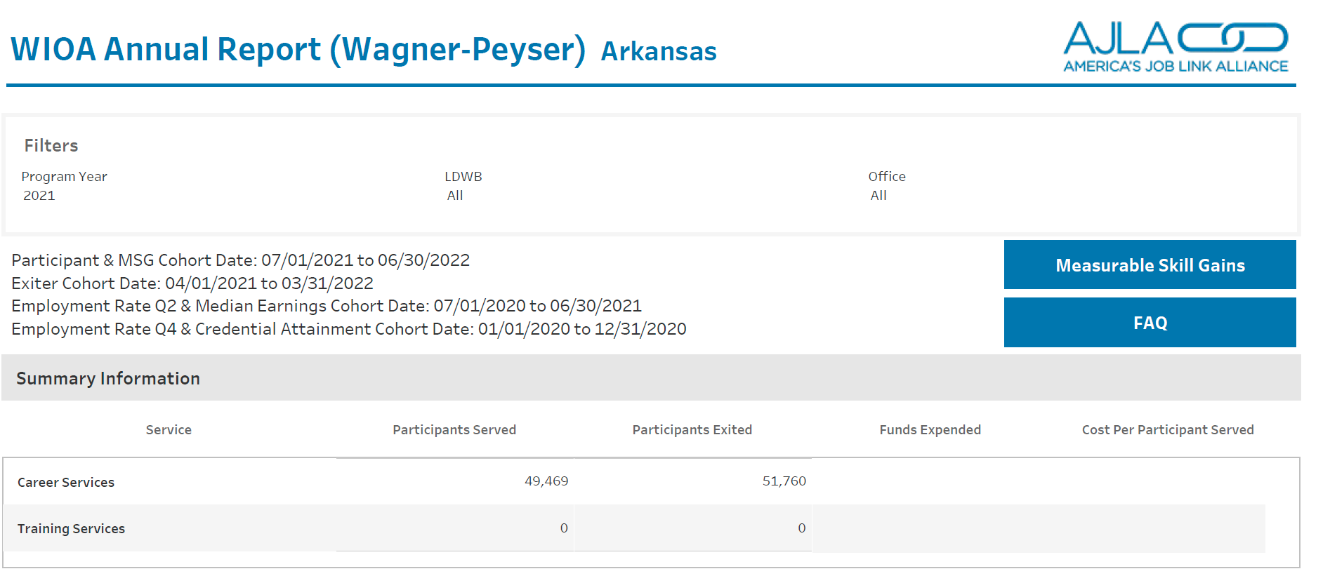
WIOA- Title III- PY’ 2021
TARGETS
73.4%
74.5%
$5,200

